Slide 1
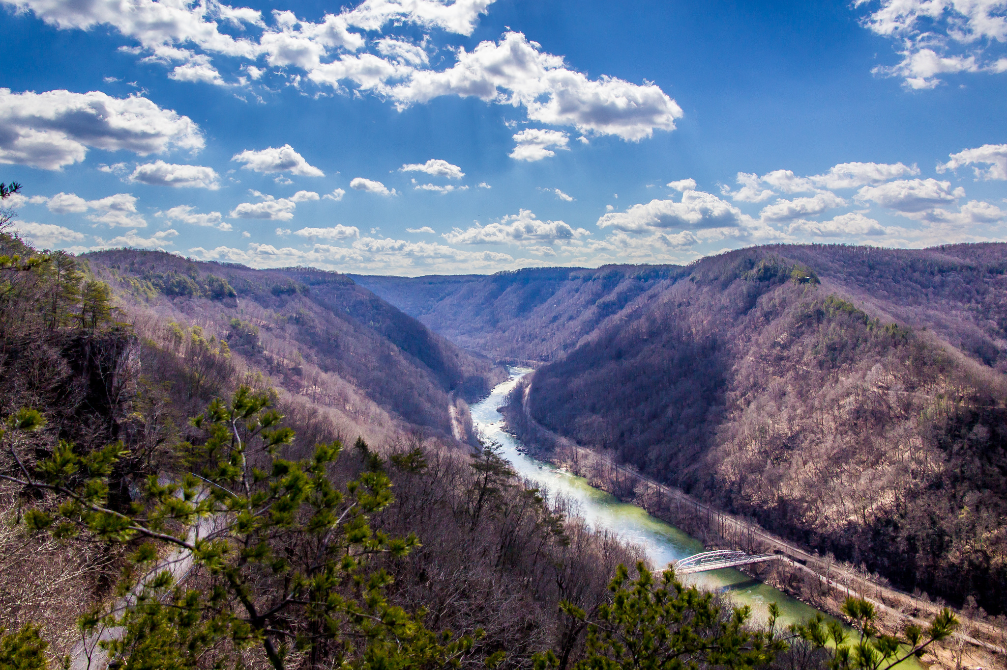

Is West Virginia Poor?
An economic analysis of west Virginia and her counties

Slide 2
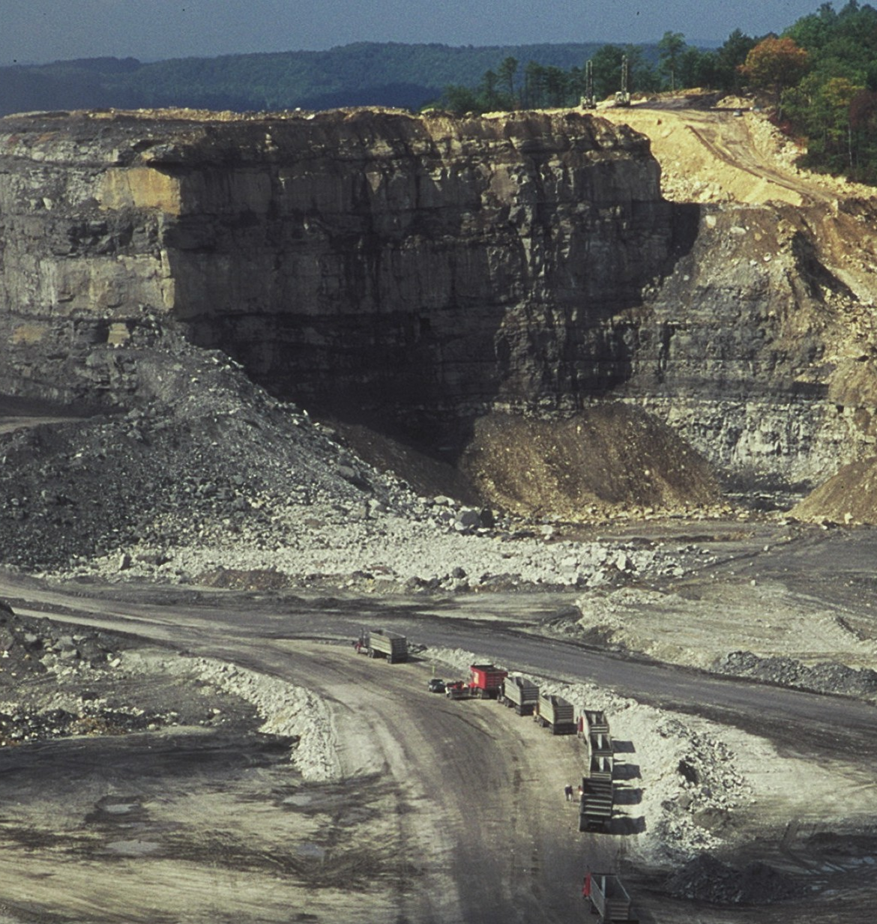
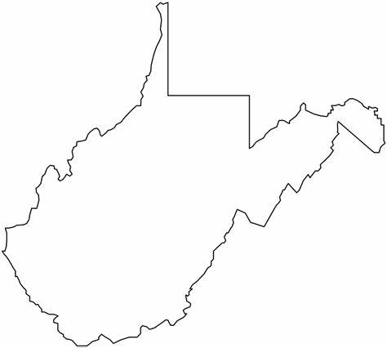

West Virginia is known for many things
WVU Sports
Coal Industry
Poverty?

Slide 3
Is West Virginia Poor?

Slide 4
Data
Data on all the counties in the US (including Washington DC)
Includes records such as percent of people below poverty level, average income, unemployment rate
Main dataset on GitHub: https://github.com/Deleetdk/USA.county.data
FIPS codes dataset on Kaggle: https://www.kaggle.com/datasets/danofer/zipcodes-county-fips-crosswalk

Slide 5
What percent of people in West Virginia are below the poverty level and how does that compare to the rest of the US?
Question 1 – Poverty

Slide 6

Poverty (cont.)
In West Virginia, the percent of citizens below the poverty level is 17.8%.
This is 7th highest among states in the US.

Slide 7
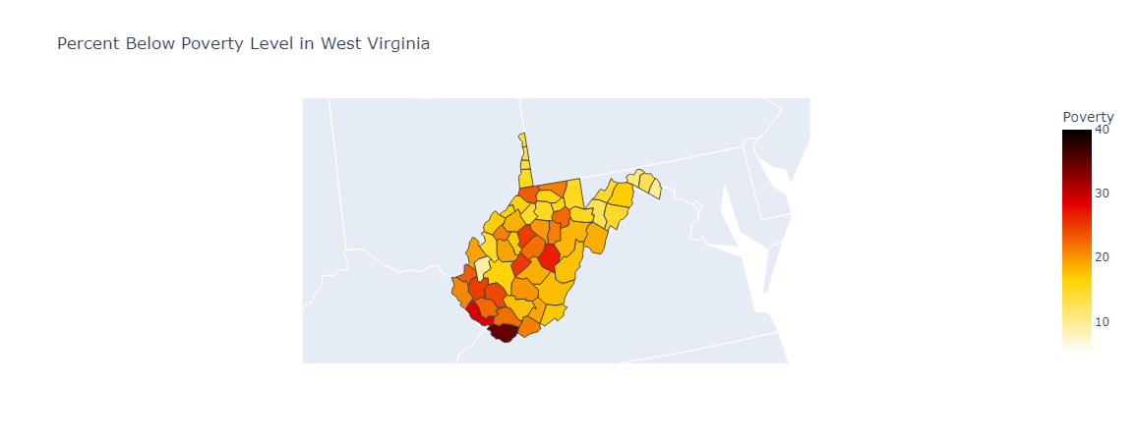
Poverty (cont.)

Slide 8


Poverty (cont.)
Putnam
County

Slide 9
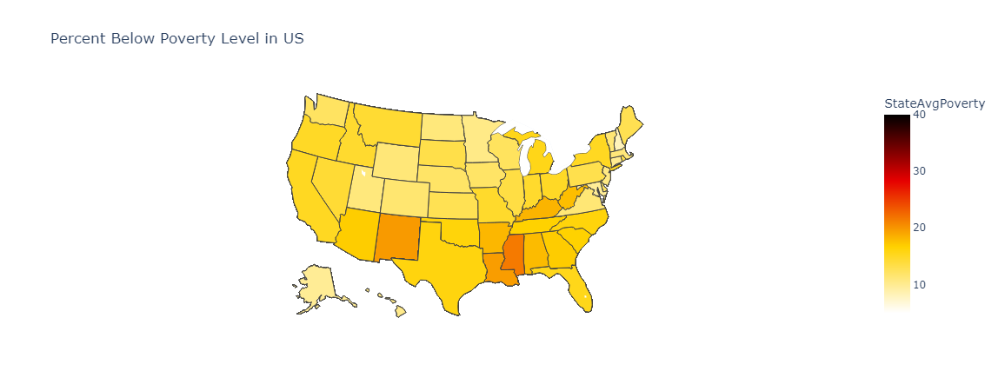
Poverty (cont.)

Slide 10
What are the average incomes in individual counties in West Virginia and how does West Virginia's average income compare to the rest of the US?
Question 2 – Average Income

Slide 11

Average Income (cont.)
In West Virginia, the average income is $45,620.
This is 3rd lowest among states in the US.

Slide 12
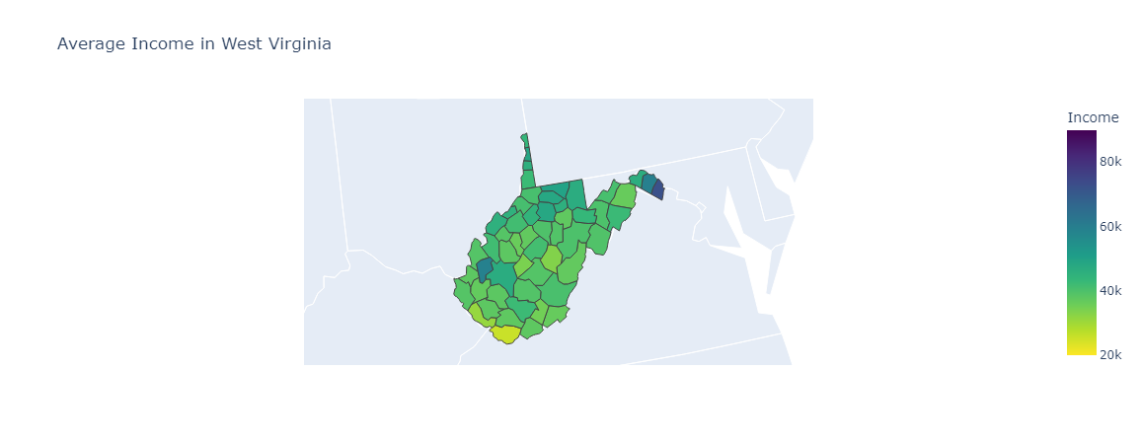
Average Income (cont.)

Slide 13
Average Income (cont.)
Putnam
County

Slide 14
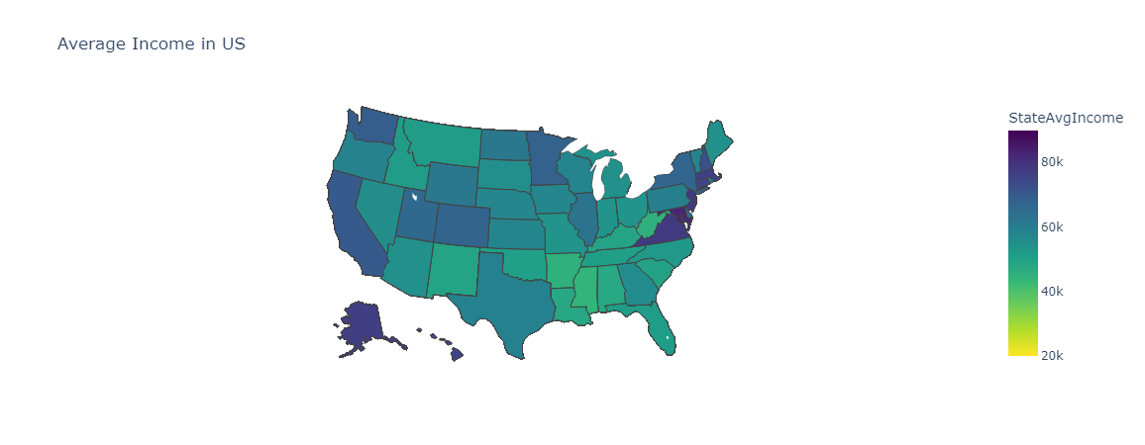
Average Income (cont.)

Slide 15
Is there a correlation between the 20 West Virginia counties that have the largest percent of people below the poverty level, the 20 counties with the smallest average incomes, and the 20 counties with the largest unemployment rates? If so, which counties are they and are they geographically close?
Question 3 – Poorest Counties

Slide 16

Poorest Counties (cont.)
There are 10 counties in WV that are among the worst 20 counties when it comes to all three of poverty, income, and unemployment.
Those counties are McDowell, Mingo, Webster, Clay, Gilmer, Boone, Barbour, Logan, Wyoming, and Wayne County.

Slide 17
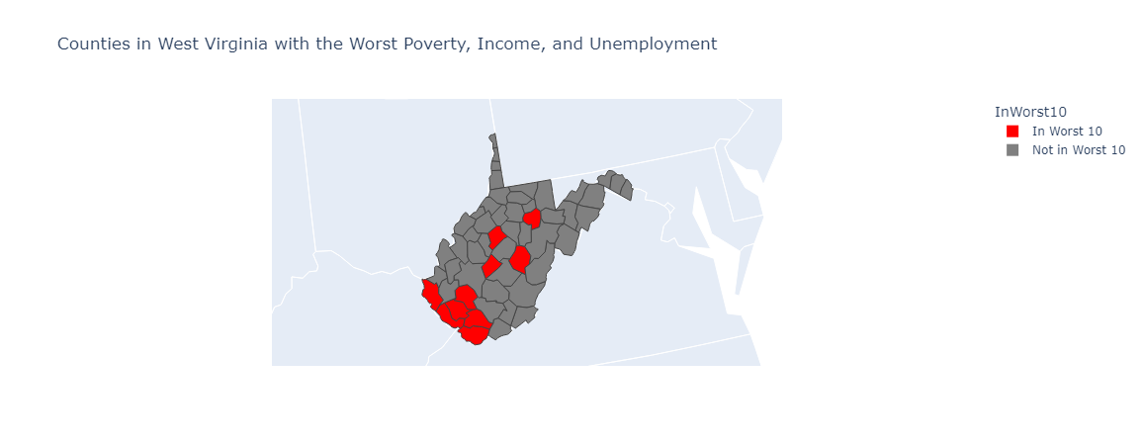
Poorest Counties (cont.)

Slide 18

Is this a problem just in south-western West Virginia or is this also a problem in nearby counties in other states?

Slide 19
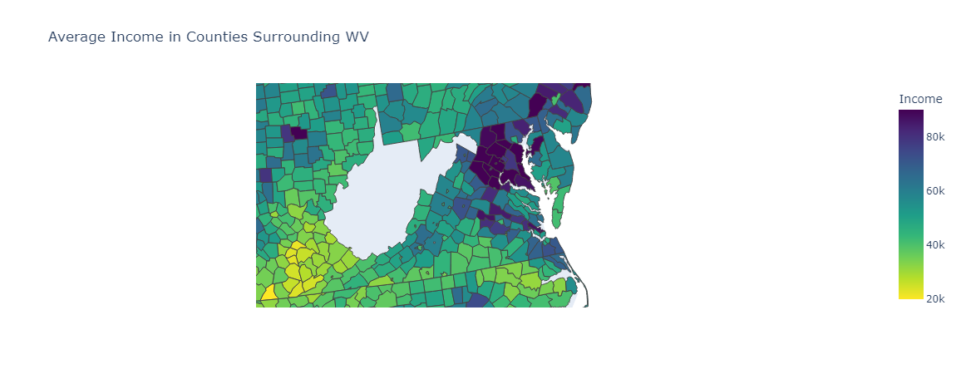
Average Income for Surrounding Counties

Slide 20

Average Income for Surrounding Counties

Slide 21

Average Income for Surrounding Counties

Slide 22
Conclusion
West Virginia is clearly poorer than the rest of the US.
South-western West Virginia and the surrounding counties in other states are very poor.

